Slide 1

WELCOME to NETFLIX Movies and TV Shows!!
Thank you for visiting my project
Please kindly use Slide Show or press F5 for better visualization
Hope you enjoy!

Slide 2

Movies and TV Show
Project by Louisa Veronica

Slide 3

Business Understanding
Business Benefit
Challenge
Streaming service that offer movies and TV shows based on paid subscription
Insight on Netflix’s content, thus providing valuable data during strategy planning
Afford increment on customer’ satisfaction by providing them with better experience when browsing Netflix’s content
Big number of data
Missing value
Column with wrong data types
Less information to create recommendation

Slide 4

Data Source:
https://www.kaggle.com/datasets/shivamb/netflix-shows
Data Detail:
show_id: ID of each show
type: show category, whether movies or TV show
title: movies or TV shows’ title
director: movies or TV shows’ director
cast: movies or TV shows’ actor or actress
country: country where movies or TV shows are produced
date_added: date movies or TV shows added to Netflix
release_year: movies or TV shows’ actual release year
rating: movies or TV shows’ rating
duration: movies or TV shows’ duration, whether in minutes or season(s)
listed_in: movies or TV shows’ genre
description: movies or TV shows’ description

Slide 5

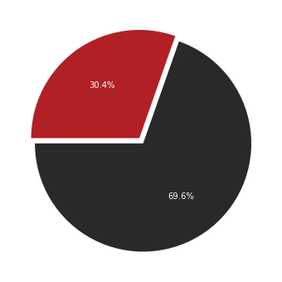
Netflix has a lot of movies and TV shows:
6131 movies
2676 TV shows

Slide 6


Most Used Words in Netflix’s title

Slide 7


Most Used Words in Netflix’s description

Slide 8

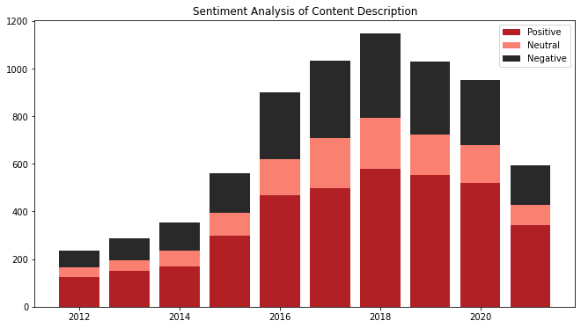

Slide 9


Slide 10

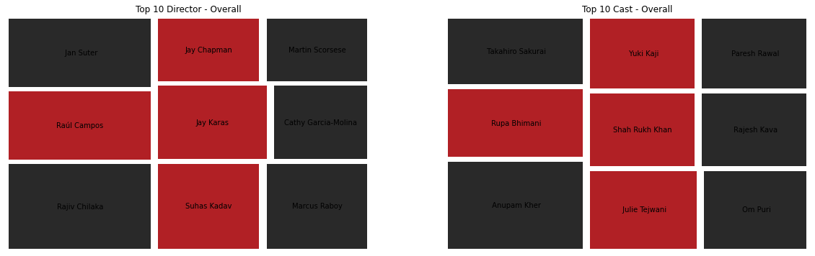
DIRECTOR

Slide 11
CAST

Slide 12

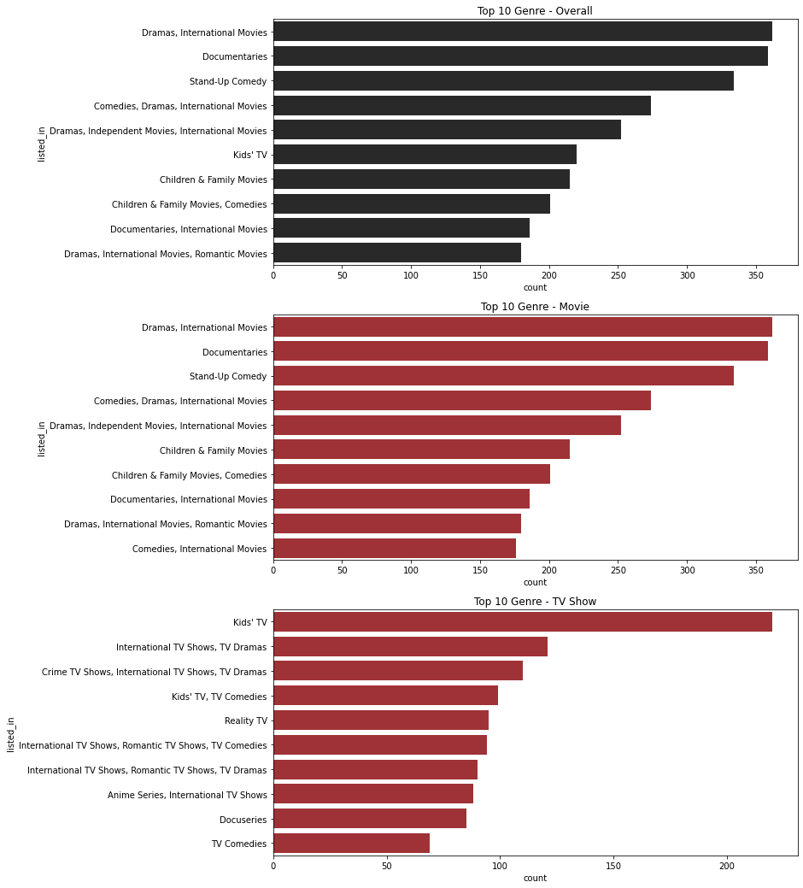
GENRE

Slide 13



TOO MANY MOVIES AND TV SHOWS, WHAT TO WATCH???
Don’t worry, Click below!

Slide 14
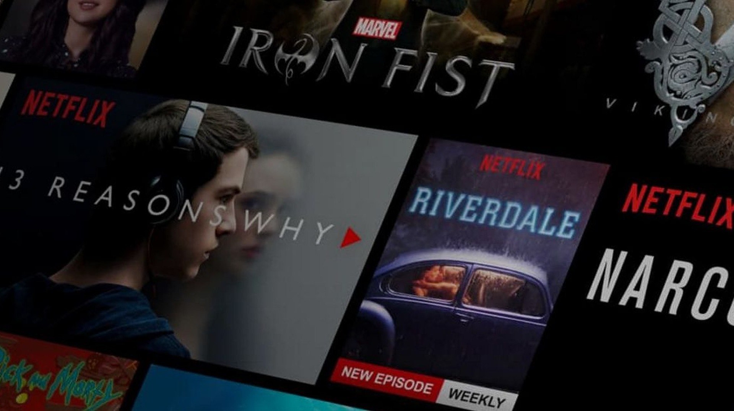

Creating a recommendation system that will suggest other movies or TV shows titles based on inputted title
Insert Movies or TV Shows Title Here

Slide 15



Insert Movies or TV Shows Title Here
Search

Slide 16





Search
Naruto

Slide 17

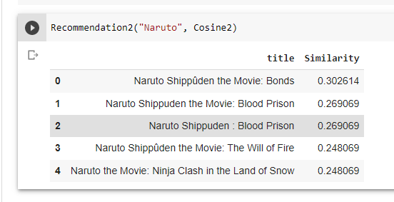
Model Result
Best recommendation system is created by using Count Vector to process director, cast, listed-in(genre), and description column and calculate Cosine Similarity

Slide 18
Conclusion
Netflix has more movies than TV shows with most of the content contain life, love, world, man, and woman
Most directors are from US, while most of actor and actress are from India, telling the same story that most movies and TV shows were produced in US and India
Most movie’s genre is dramas, international film under TV-MA rating and having around 90 mins duration
Most TV shows’ genre is Kids TV , however, rating is under TV-MA, and mostly having only 1 season
Adding more feature to the recommendation system give more accurate result

Slide 19
Suggestion
Create recommendation system by using:
other method (clustering, etc)
other dataset to be combined with this dataset (guest preference, shows score, etc) to create collaborative-based-filtering

Slide 20

Link to project:
https://github.com/LouVe92/Netflix-Movies-and-TV-Shows-Analysis
Model Result
THANK YOU
LinkedIn: https://www.linkedin.com/in/louisa-veronica

